Slide 1
Fastag Fraud Detection Project
Approach and Key Findings

Slide 2

Introduction
Fastag is an electronic toll collection system in India that uses Radio-frequency Identification (RFID) technology to make toll payments directly from a prepaid account linked to it. Essential for financial security, trust, and reliability in the Fastag system.
Project Goals
Develop a robust machine learning model for Fastag fraud detection.
Implement real-time fraud detection for heightened system security.

Slide 3

Problem Statement
With the increasing adoption of Fastag, the risk of fraudulent transactions rises significantly. A robust fraud detection system is crucial for preventing financial losses due to fraudulent activities.

Slide 4
Data Overview
Key Features
Lane_Type
Vehicle_dimentions
Vehicle_Speed
Transaction_Amount
Amount_Paid
Target Variable
Fraud_Indicator

Slide 5
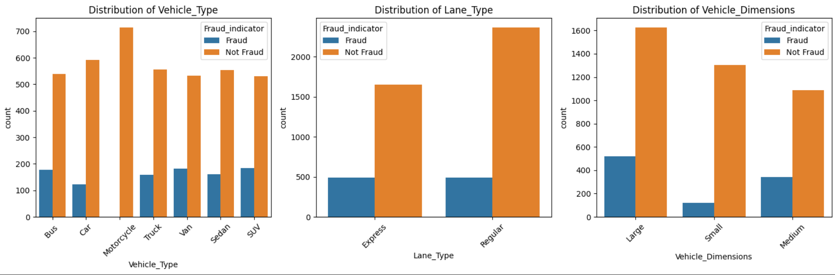
Data Overview

Slide 6
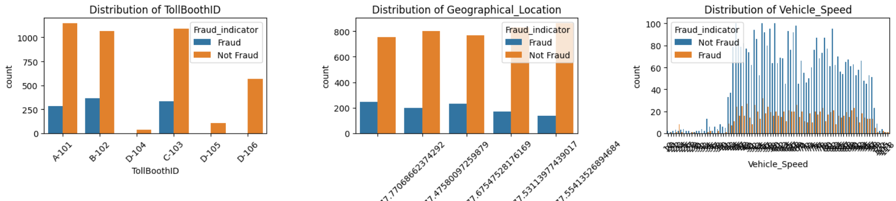
Data Overview

Slide 7
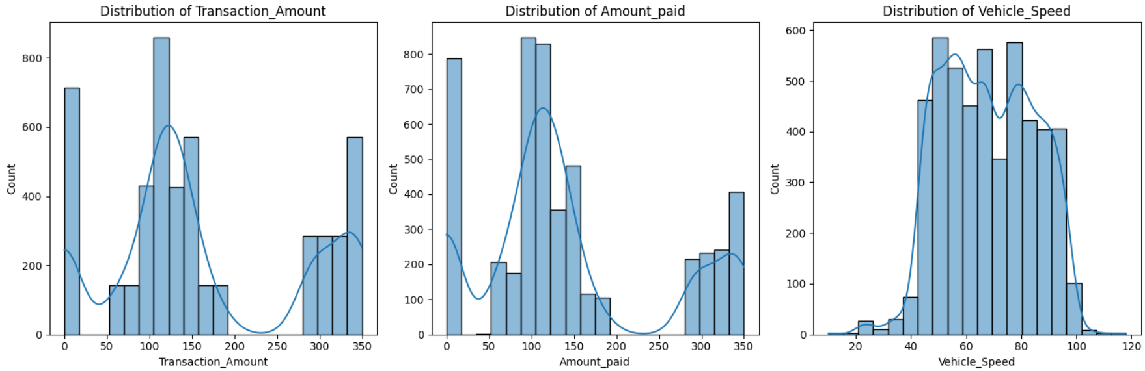
Data Overview

Slide 8
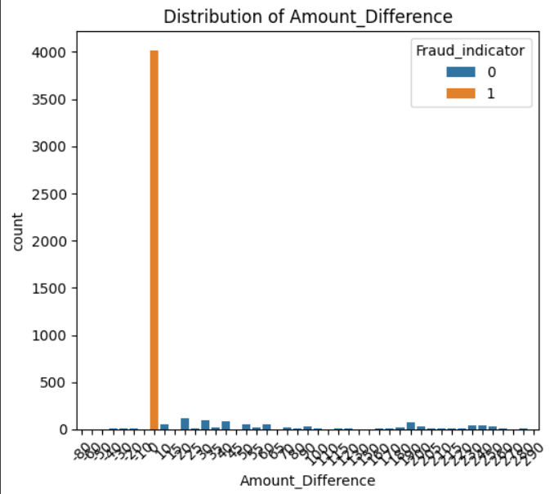
Feature Engineering
Created a new column, 'Amount_Difference', in the dataset, representing the variance between the actual transaction amount and the amount paid. This allows the model to capture discrepancies between expected and observed payment values, potentially aiding in detecting anomalies or fraudulent transactions.

Slide 9
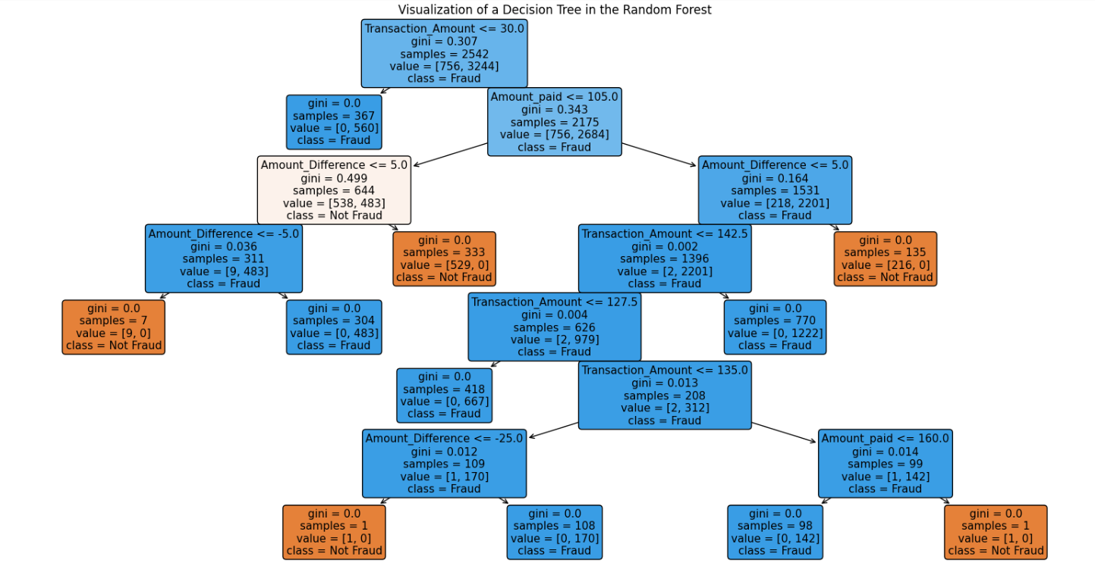
Model Development

Slide 10
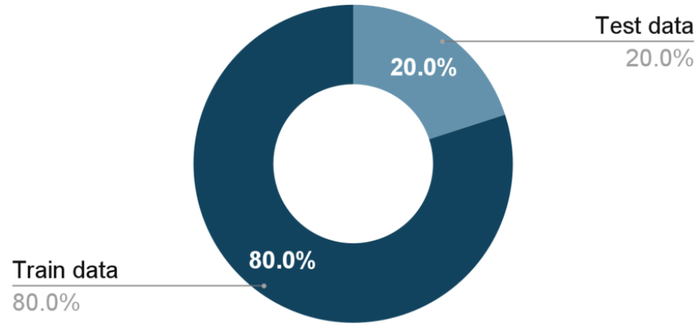
Splitting the Dataset
Segmented the dataset into training and testing sets (80% training, 20% testing).

Slide 11

Model Training
Chose a Random Forest model for its ensemble of decision trees and inherent ability to handle diverse features.
Trained the model on the training set and predicted fraud on the test set.

Slide 12
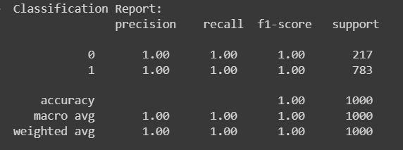

Evaluation Metrics
.

Slide 13
Conclusion
Selection of Random Forest was driven by its adaptability to diverse feature types present in Fastag transactions.
The model demonstrated robust performance, achieving a commendable accuracy score.
Regular updates and enhancements are essential to staying ahead of evolving fraud tactics.
The successful implementation of the Fastag fraud detection system not only ensures financial security but also contributes to maintaining user trust in the Fastag ecosystem.
The impact extends beyond accurate detection, positively influencing the overall integrity and sustainability of the system.

